Slide 1
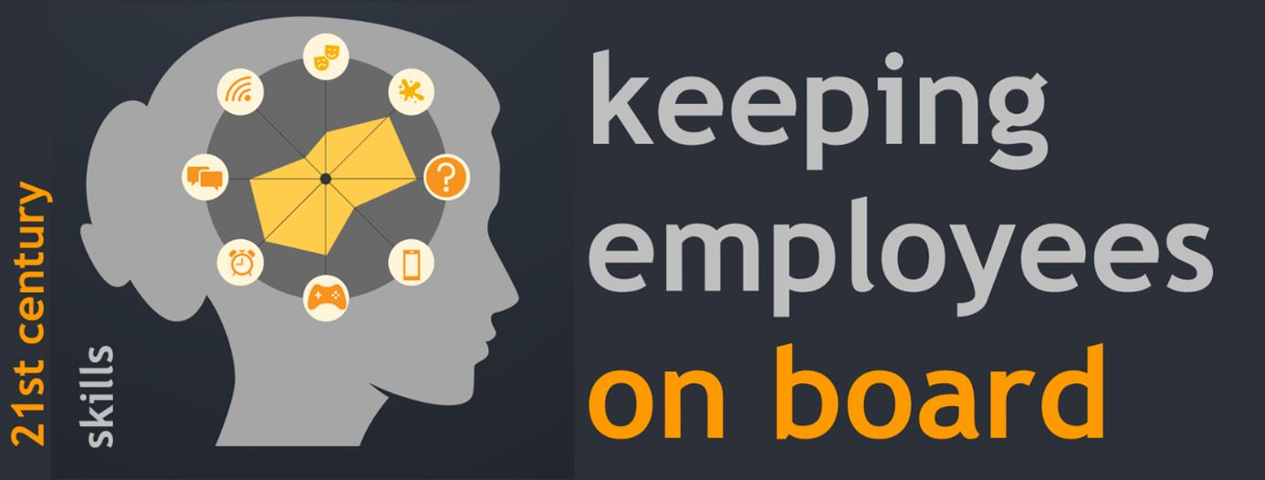
International Conference 19th June 2023 Workshop Jobcrafting
Notes:
Also telling something about ourself

Slide 2
Welcome
What is jobcrafting?
Experiences with jobcrafting from practice?
Notes:
Some questions to discover how much knowledge does the audience have about this topic. How much time?

Slide 3
What is jobcrafting?
possibilities
Job crafting is building a job that fits to the needs en possibilys of the employee and the needs of the organisation
Notes:
Craften can also be carving

Slide 4
Job versus employee
Job
Employee
Collection of
Tasks/activities
Orders
Projects
Strongs / weakness
Needs/motives Physical./cog. Capabilities Interests/passions

Slide 5
Timetabel of a job
Starting
a job
ideal situation of a job
reality (over the years)
Notes:
If the job does no longer fit to the employee. It is time tot start with job crafting. Job crafting can be used for long time solutions but also for short time solution. There are different possibilities to craft a job.

Slide 6
Stap 1: Job in tasks
Tasks are different when they are e.g.:
Require other knowledge/skills They serve a different purpose You do them with others/ do them alone You do them at a different time/place

Slide 7
Look at your own job in tasks
Write 10 different tasks on 10 yellow post-its
GOAL:
A quick first average image of the activities/tasks that make up the job
TIME: 15 min

Slide 8
Step 2: Need customization?
Do these tasks still suit this employee under the current circumstances?
Can I still good (on)
Do I want to less
Do I want still happy
Can I then less good (on)

Slide 9
Stap 3: Jobcrafting
FUNCTION A
Employee 1
Employee 2
Jobcrafting techniques
cognitive crafting (Wrzesniewski en Dutton (2001)
by customizing tasks Changing work-related social relationships by changing their own perception of their work
Balancing task demands and resources (Bakker & Demerouti, 2017 ; Demerouti et al., 2001)
Source:
A person-centered investigation of two dominant job crafting theoretical frameworks and their work-related implications
?

Slide 10
Discussion
Looking after the tasks on the post its of your own job
How can you apply this knowledge to yourself? What's in it for you if you do this?
How and who/what do you need for that?
Notes:
How much time?

Slide 11
More information
A person-centered investigation of two dominant job crafting theoretical frameworks and their work-related implications
Crafting a Job: Revisioning Employees as Active Crafters of Their Work
Unraveling the complex relationship between career success and career crafting: Exploring nonlinearity and the moderating role of learning value of the job

